Slide 1
COSC 1437.01
PROGRAMMING FUNDAMENTALS II
LECTURE 6. A LIST IMPLEMENTATION THAT USES AN ARRAY

Slide 2
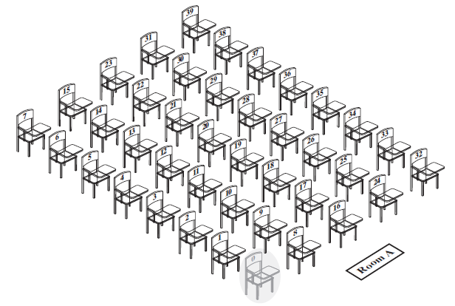
Array to Implement the ADT List
FIGURE 13-1 A classroom that contains
desks in fixed positions

Slide 3
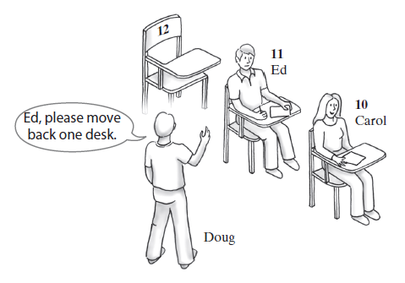
Array to Implement the ADT List
FIGURE 13-2 Seating a new student between two existing students: At least one other student must move

Slide 4
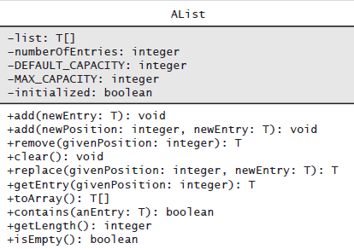
Array to Implement the ADT List
FIGURE 13-3 UML notation for the class AList

Slide 5
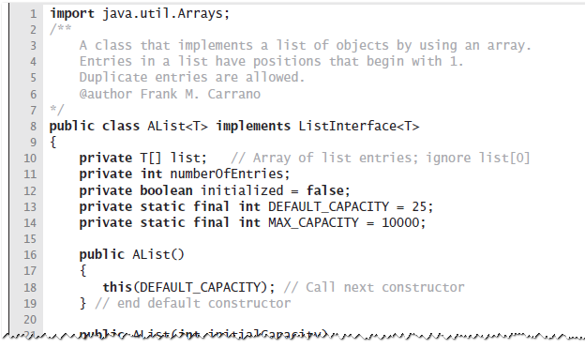
Array to Implement the ADT List
LISTING 13-1 The class AList

Slide 6
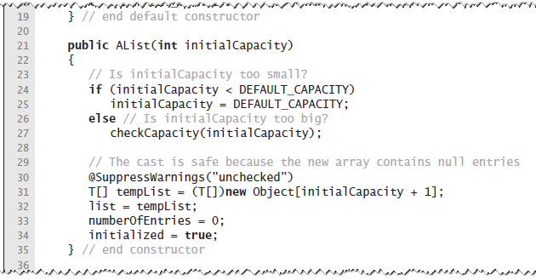
Array to Implement the ADT List
LISTING 13-1 The class AList

Slide 7
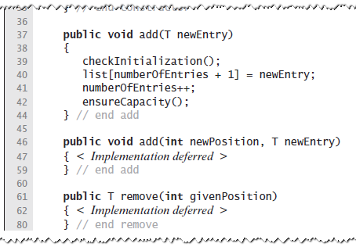
Array to Implement the ADT List
LISTING 13-1 The class AList

Slide 8
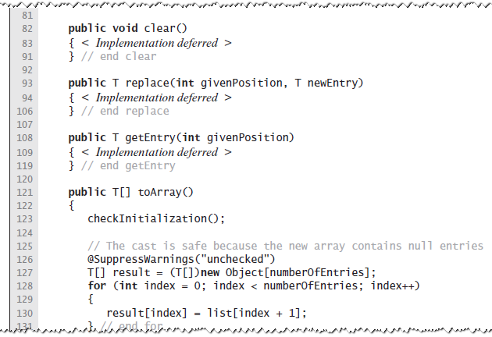
Array to Implement the ADT List
LISTING 13-1 The class AList

Slide 9
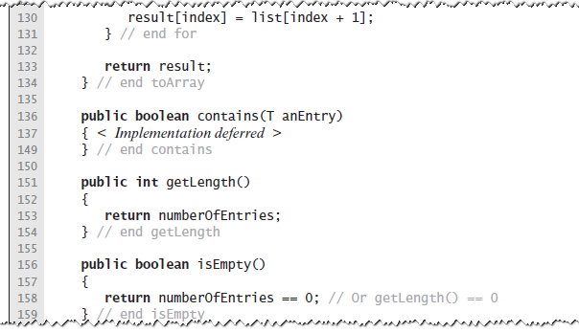
Array to Implement the ADT List
LISTING 13-1 The class AList

Slide 10
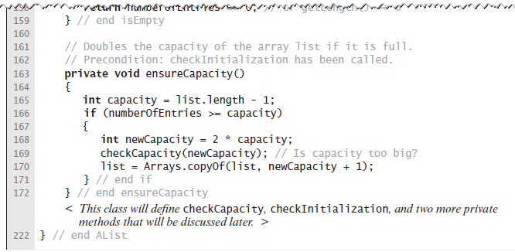
Array to Implement the ADT List
LISTING 13-1 The class AList

Slide 11
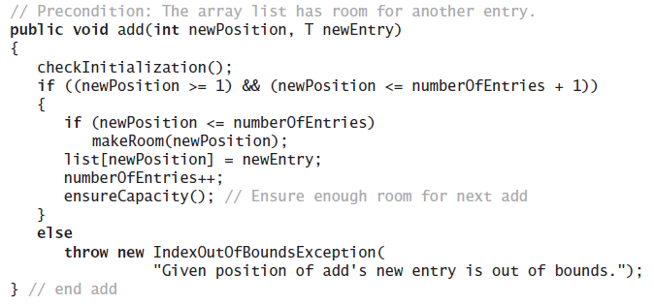
Array to Implement the ADT List
Implementation of add uses a private method makeRoom to handle the details of moving data within the array

Slide 12
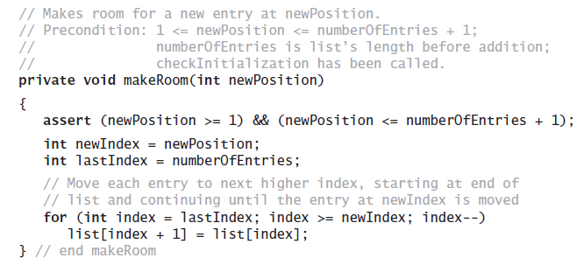
Array to Implement the ADT List
Implement the private method makeRoom

Slide 13
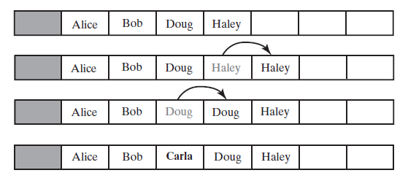
Array to Implement the ADT List
FIGURE 13-4 Making room to insert
Carla as the third entry in an array

Slide 14
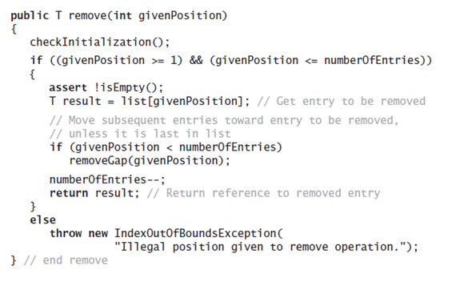
Array to Implement the ADT List
Implementation uses a private method removeGap to handle the details of moving data within the array.

Slide 15
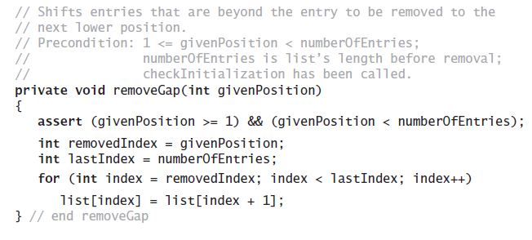
Array to Implement the ADT List
Method removeGap shifts
list entries within the array

Slide 16
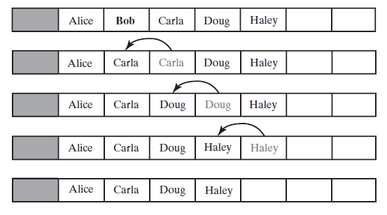
Array to Implement the ADT List
FIGURE 13-5 Removing Bob by shifting array entries

Slide 17
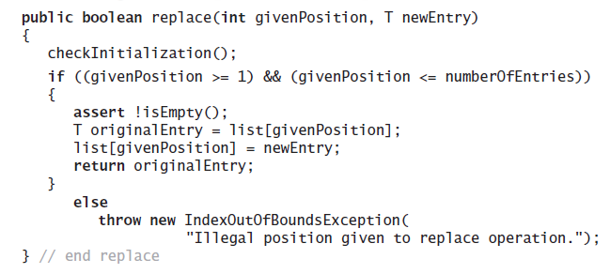
Array to Implement the ADT List
Method replace

Slide 18
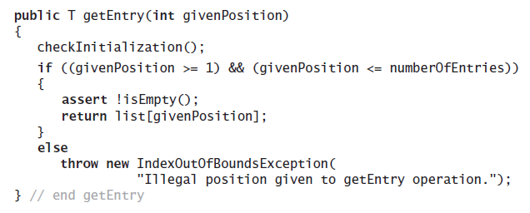
Array to Implement the ADT List
Method getEntry

Slide 19
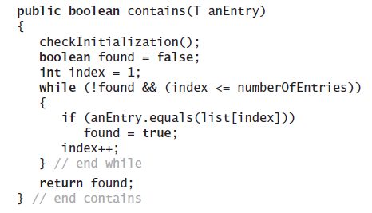
Array to Implement the ADT List
Method contains uses a local boolean variable to terminate the loop when we find the desired entry.

Slide 20
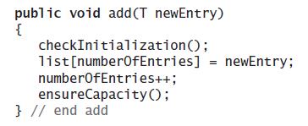
Array to Implement the ADT List
Operation that adds a new entry to the end of a list.
Efficiency O(1) if new if array is not resized.

Slide 21
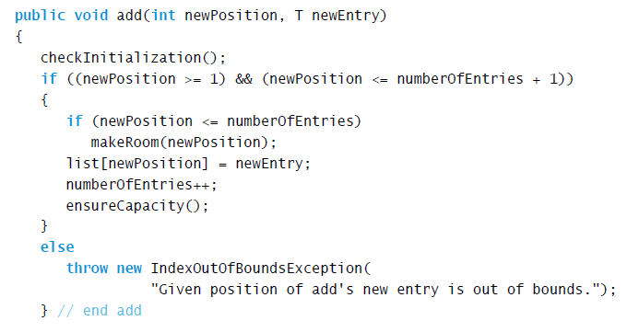
Array to Implement the ADT List
Add a new entry to a list at a client-specified position.

Slide 22
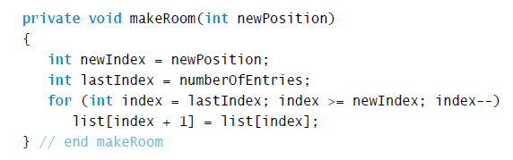
Array to Implement the ADT List
Method add uses method makeRoom.

